Slide 1


Design and Fabrication of a Deep-Space Habitat Mockup for Human/Robot/System Interaction Research
By Angel Rodas
Human/Robotics/Vehicle Integration & Performance Laboratory

Slide 2
About the Speaker
Name: Angel Rodas
NSF CAMP Scholar
Mechanical and Aerospace Engineer
Project Lead of the Deep-Space Habitat Mockup
Designing and Building an Off-Earth Habitat Mockup on Earth!
Notes:
-Keep it general we will get more specific in the following slides
-Say Personally you see yourself as Science Student, Engineering Enthusiast, and Aerospace Aficionado
-Mention that the project you will be discussing is the Deep Space Habitat Mockup.
-Mention your fascination with flying machines and space since watching Star Wars and Top Gun as a child.

Slide 3
About H.O.M.E
Habitats Optimized for Missions of Exploration
NASA Space Technology Research Institution
Collaborative effort involving multiple universities and commercial partners
Developing Next-Gen Space Exploration Technology
Lessen Reliance on Earth
Following Photos Courtesy of NASA...
Notes:
-Keep it general we will get more specific in the following slides
-Say Personally you see yourself as Science Student, Engineering Enthusiast, and Aerospace Aficionado
-Mention that the project you will be discussing is the Deep Space Habitat Mockup.
-Mention your fascination with flying machines and space since watching Star Wars and Top Gun as a child.

Slide 4
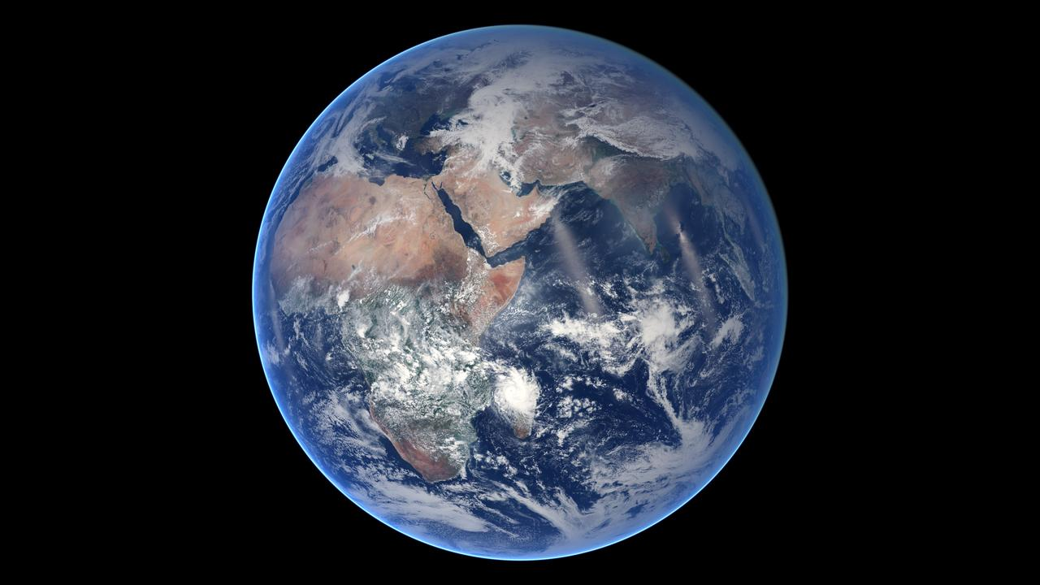

Slide 5
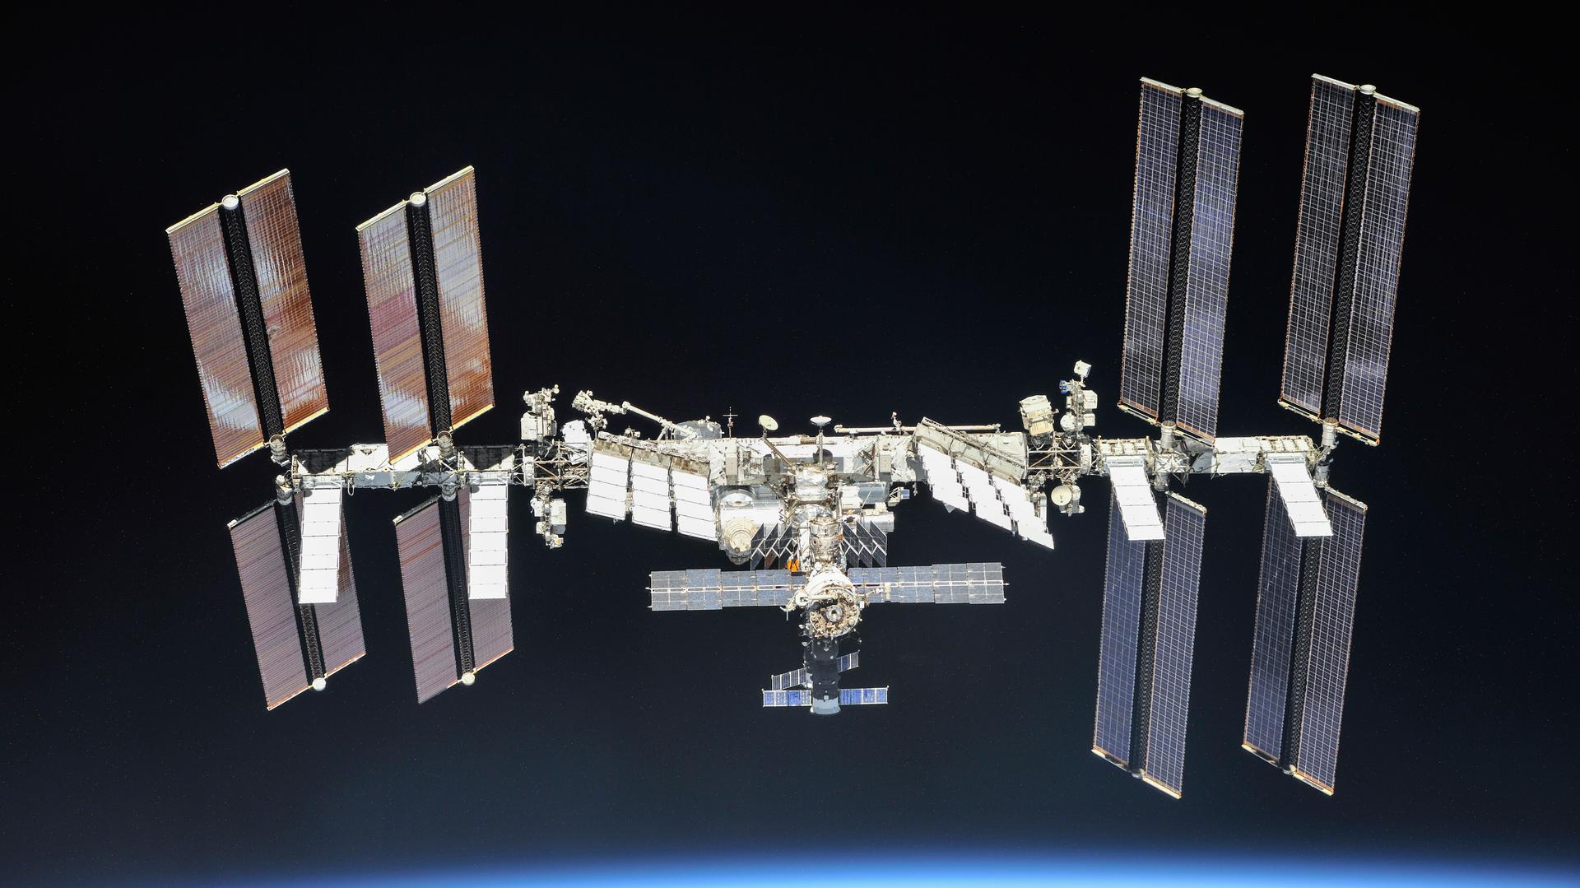

Slide 6
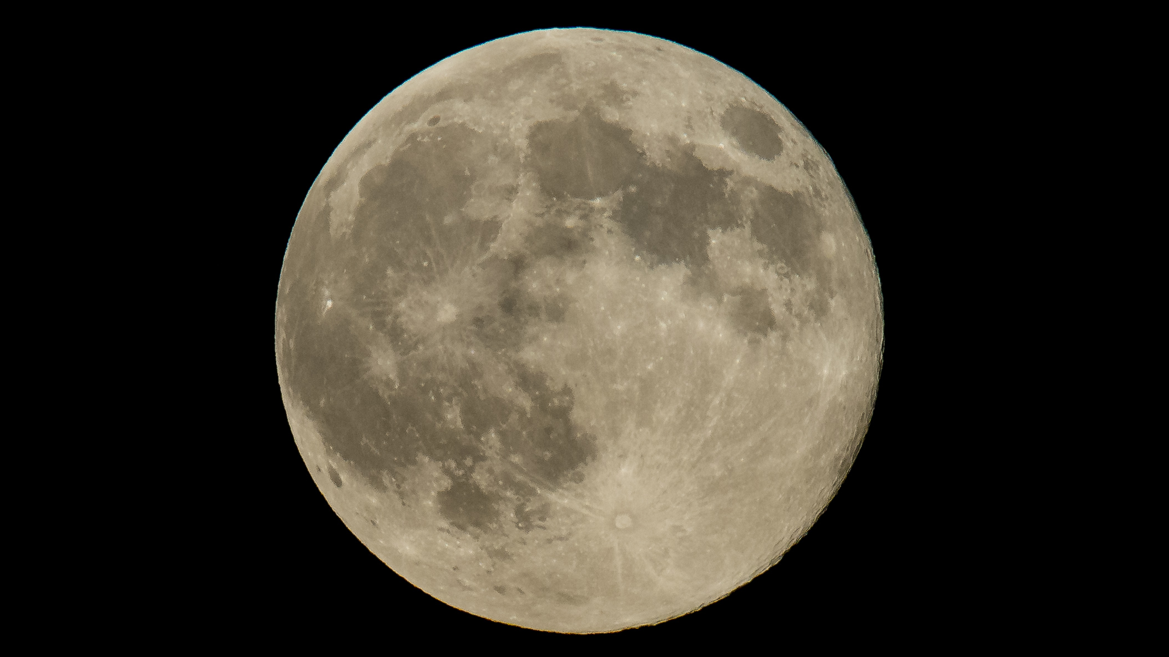


Slide 7

Current Efforts
Developing Autonomous Robotic collaboration technology
Life Support Systems
Machines to improve quality of life in space
HRVIP Lab
Notes:
-Mention that they have a whole list of what research they are doing and when listed on the HERA page of the NASA website.

Slide 8
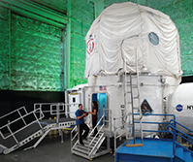
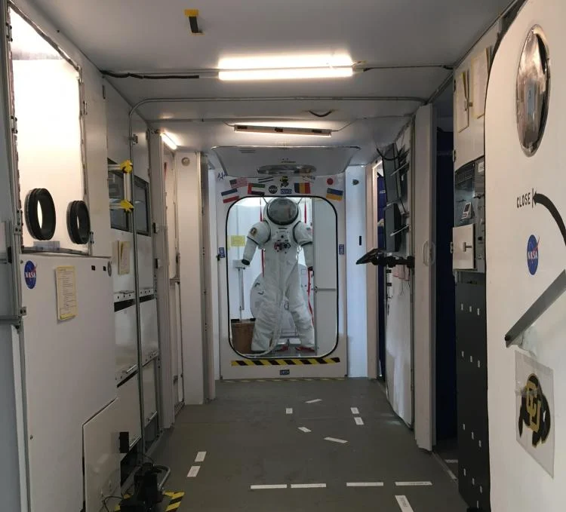
Similar Research and Facilities
Human Exploration Research Analog (HERA)
CU Boulder HOME Mockup​
Notes:
HERA
Behavioral health and performance studies
Communication and autonomy studies
Human factors evaluations
Medical capabilities assessments
Cu Bolder
Investigate human health and performance
Develop environmental control systems

Slide 9
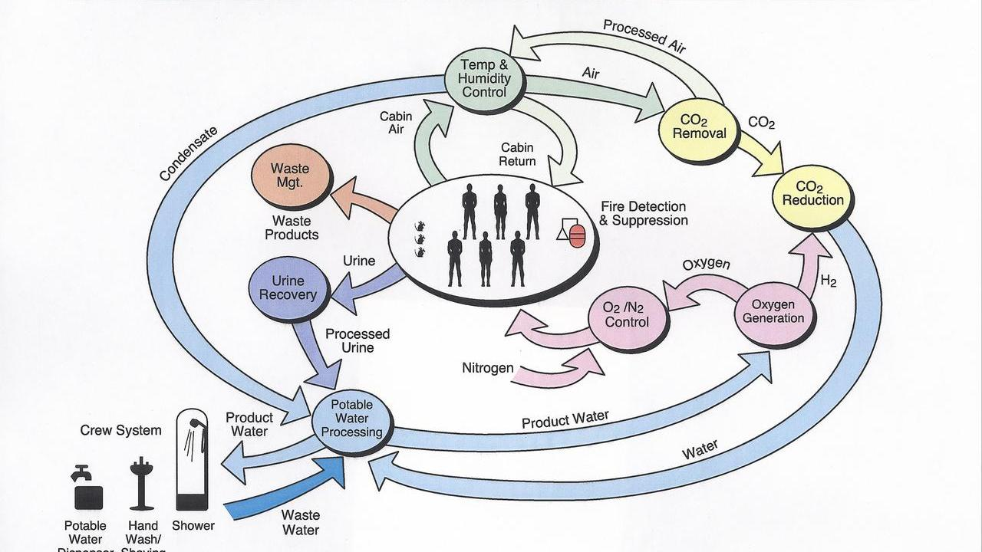
Our Research
Human/Robot/System Interaction Research
Notes:
-Mention that they have a whole list of what research they are doing and when listed on the HERA page of the NASA website.

Slide 10
Requirements
Build a durable, safe, and easily maintainable simulated deep space habitat which is affordable and accessible
Give researchers and subjects a low-risk and low-cost platform to improve solutions to the challenges of operating in a deep space habitat
Notes:
-Explain who the all is, Institutions, Organizations, or groups that wish to test their protocols, experiments, and psychology in as close to a space like environment without the risk or expense of going to space.
-Challenges include but are not limited to: Isolation, Confinement, remote environment, communication delay, communication loss just to name a few.

Slide 11
Solutions
Designed to be modular (easily reconfigured, upgraded, and expanded)
Disassembled and reassembled with Minimal Work
Can be assembled for years at a time
Well-documented, easily repeatable design for future expansion
Reasonable price for construction and maintenance

Slide 12
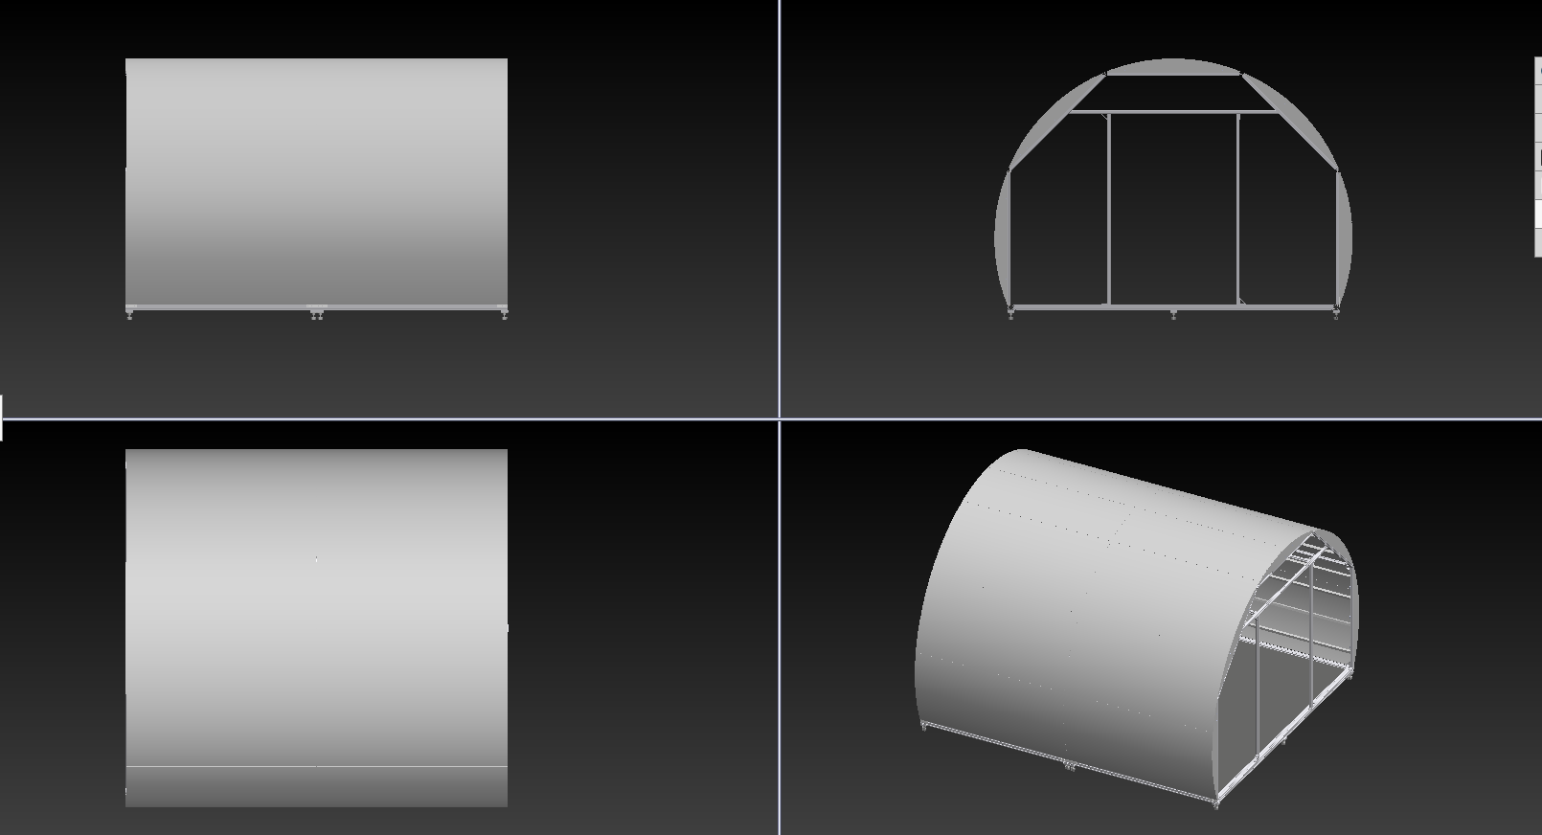
Our Design

Slide 13
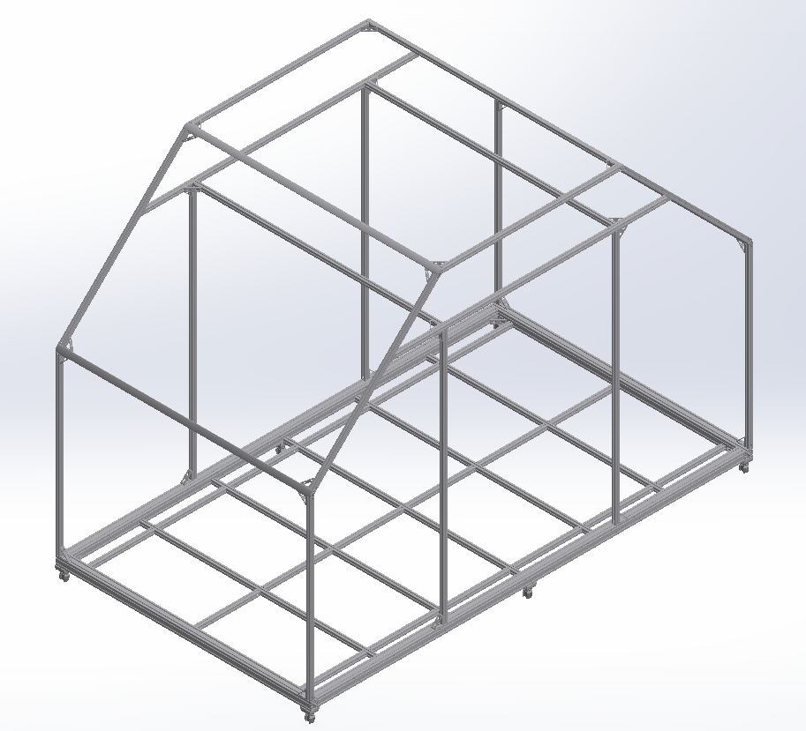
Discussion
We started with the frame
The frame is made of 80/20 Aluminum
Floor can hold 1500lbf and fit 7 people with 3 ft of space each
Notes:
-Explain because it is the most logical place to start. Dictates the Interior design in terms of usable space.

Slide 14
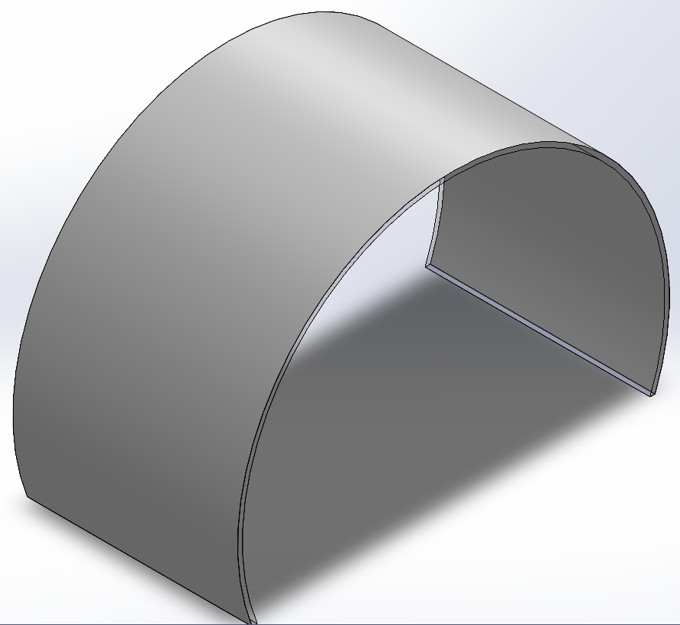
Discussion
Semi-Cylindrical exterior shell
Shell is made of Fiber Reinforced Plastic (FRP)
Notes:
-Explain because it is the most logical place to start. Dictates the Interior design in terms of usable space.

Slide 15

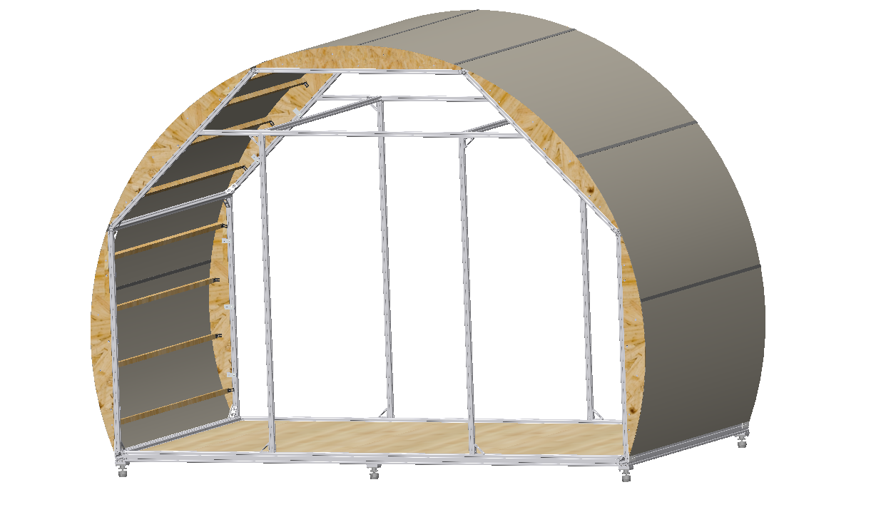
Discussion
8 Panels connected with plastic H Channels
Notes:
-Explain because it is the most logical place to start. Dictates the Interior design in terms of usable space.

Slide 16
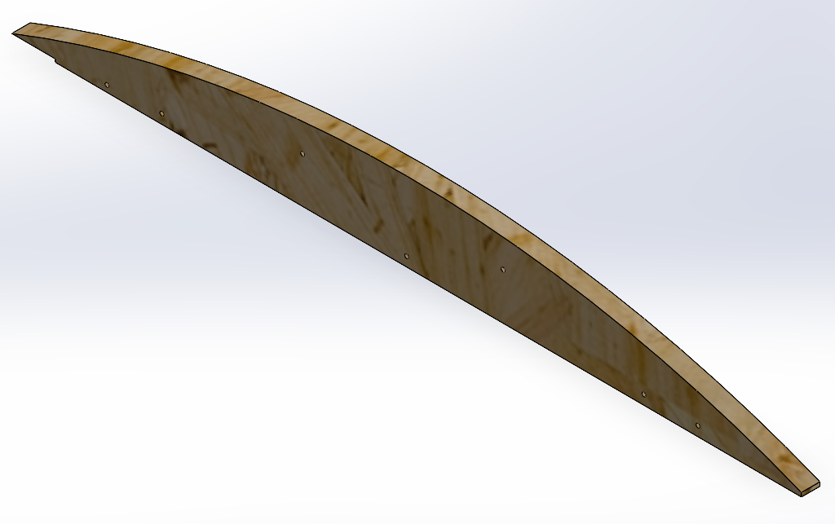
Discussion
Wooden formers attach the FRP to the 80/20 Aluminum Structure
Top Former​
Bottom Former
Notes:
-Explain because it is the most logical place to start. Dictates the Interior design in terms of usable space.

Slide 17
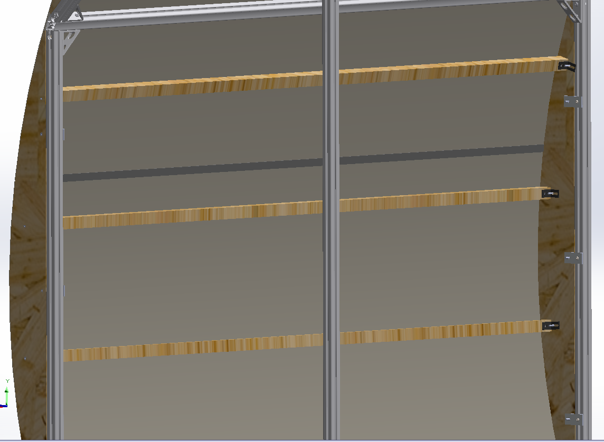
Discussion
8x2x2 Lateral Beams Provide Support to the FRP shell
Maximizes interior volume and provides utility
Notes:
-Explain because it is the most logical place to start. Dictates the Interior design in terms of usable space.

Slide 18
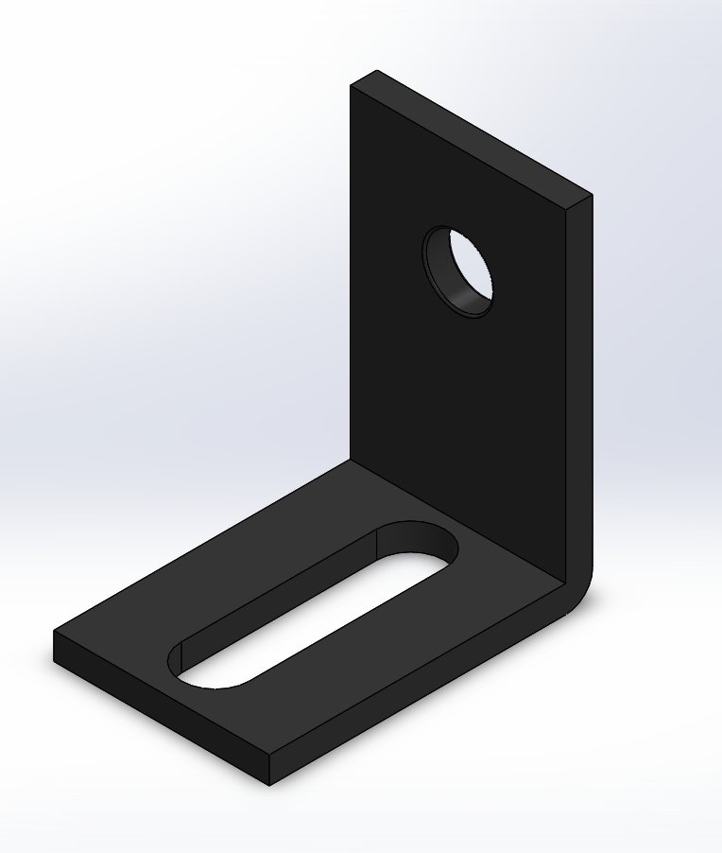
Discussion
8x2x2 brackets are slotted to account for wood dimension variability

Slide 19
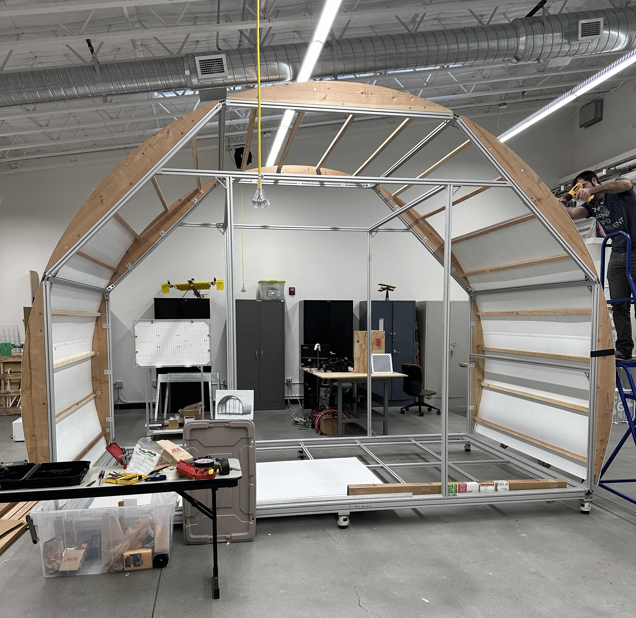
Preliminary Results
Nearing the completion of the first Habitat Module
Second one planned to bring us to full scale
Lots of ideas for adjustments for the second Habitat Module

Slide 20
Conclusion
Purpose to gain insight and experience of our technology in a low risk and low cost environment
Improve procedures, experiments, and effectiveness of research as it pertains to human, robotic, and any other system interaction
Provide a more accessible and affordable facility for any entity that would benefit from the capabilities provided by this analog

Slide 21
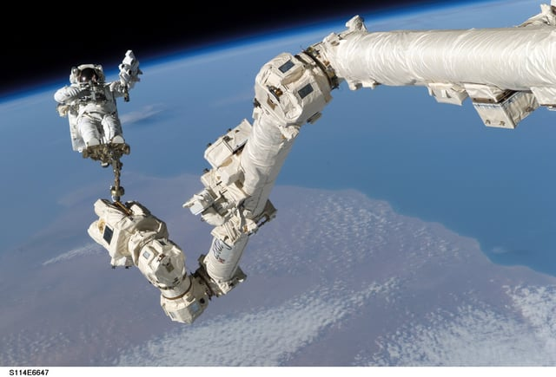
Acknowledgements
National Science Foundation's CAMP Program
Dr. Stephen K Robinson
My Fellow HRVIP Lab Members
URC, Specifically Lolita Adkins and Dr. Franz

Slide 22
References
https://hrvip.ucdavis.edu/HRVIP_projects
https://solarsystem.nasa.gov/moons/in-depth/
https://www.planetary.org/space-missions
https://www.nasa.gov/directorates/spacetech/strg/stri/stri_2018/Habitats_Optimized_for_Missions_of_Exploration_HOME/
https://howthingsfly.si.edu/ask-an-explainer/how-much-fuel-would-it-take-shoot-rocket-out-atmosphere#:~:text=A%20good%20rule%20of%20thumb,a%20rocket's%20weight%20is%20fuel.
https://www.nasa.gov/mission_pages/station/expeditions/expedition30/tryanny.html

Slide 23
Questions?

